Slide 1
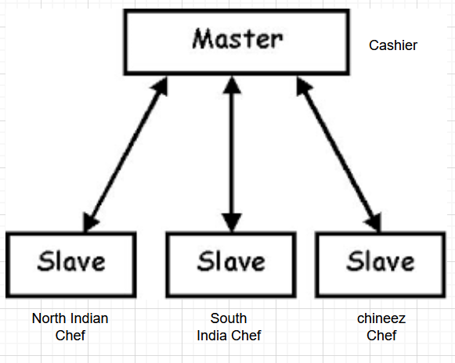
Master slave architecture > Restaurant WOW

Slide 2
WOW of Master Slave architecture
Master will take order from customer and forward it to correct slave.
Master slave is not looking good, so few people are referring it as distributed architecture.

Slide 3
Why Kubernetes
Kubernetes is the master for running the docker images, it support high cluster requirements whereas docker is a single host solution.

Slide 4
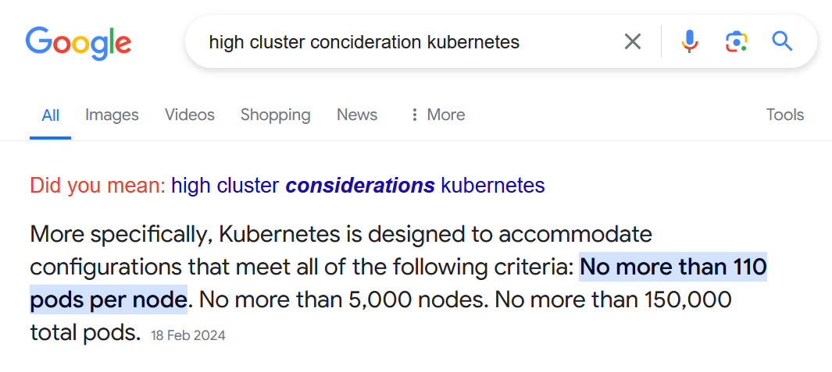

Slide 5
Pod
Container of Docker is referred as pod in Kubernetes.
Note: This is initial definition.

Slide 6
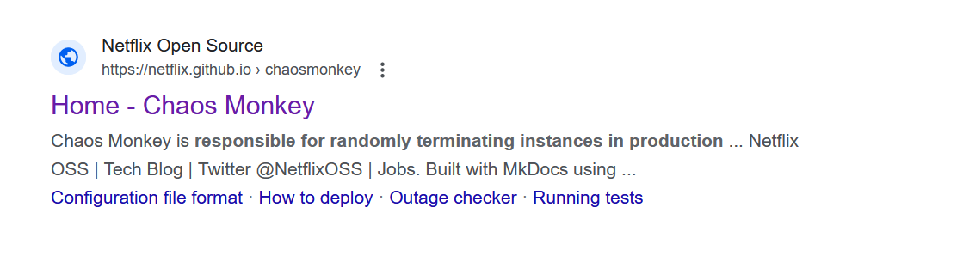
Chaos monkey

Slide 7
Desire State
Lets say I want to create 10 servers. So my desire state is 10 servers. In modern DevOps we follow these words.

Slide 8
Actual state
What we have is referred as actual state. Example I have 5 servers, then my actual state is 5 servers.

Slide 9
Fact in Morden DevOps
In modern DevOps we have cloud computing and few others similar technology which do cost optimization. So, generally what you need you will get it.
So, In Summary-
Desire state and actual state should be same.

Slide 10
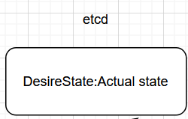
Memory part of Kubernetes
Kubernetes memory part is referred as etcd which store data in key value pair for desire state and actual state.
Desire state: actual state

Slide 11
What is desire state and actual state are not same
In this scenario, Infrastructure needs to be updated to match desire state and actual state.

Slide 12
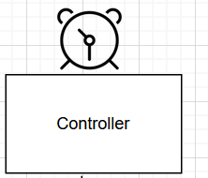
Watch function[Controller]
We have a watch function which continuously monitoring desire state and actual state, and notify to scheduler if any mismatch.

Slide 13
Schedular
Upon the instruction controller, schedular will create or delete the pods.

Slide 14
API server
If anyone want to talk to K8s cluster, they need to talk to API server.
It’s a implementation of REST API[CURD]

Slide 15
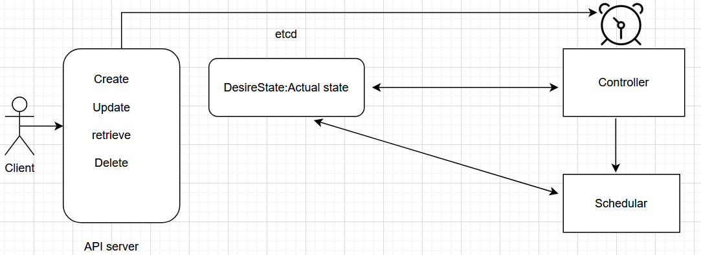
Kubernetes Master components

Slide 16
In Summary:
ETCD: Memory of Kubernetes which store desire and actual state.
Controller: It monitors Desire and actual state, and if find any gap then it inform to schedular.
Schedular: purpose of schedular is to create/delete resources.
API server: It’s implementation of REST API[CURD] where client needs to talk to API server with their requirement.
Note: When K8s API server get any request, it will talk to controller.

Slide 17
Slave components
Agent: referred as kubelet
Networking component: referred as Kube proxy
Pod: Containers.

Slide 18
kubelet
The kubelet is the primary "node agent" that runs on each node. It can register the node with the apiserver using one of: the hostname; a flag to override the hostname; or specific logic for a cloud provider.

Slide 19
kubeproxy
The Kubernetes network proxy runs on each node. This reflects services as defined in the Kubernetes API on each node and can do simple TCP, UDP, and SCTP stream forwarding or round robin TCP, UDP, and SCTP forwarding across a set of backends. Service cluster IPs and ports are currently found through Docker-links-compatible environment variables specifying ports opened by the service proxy. There is an optional addon that provides cluster DNS for these cluster IPs. The user must create a service with the apiserver API to configure the proxy.

Slide 20
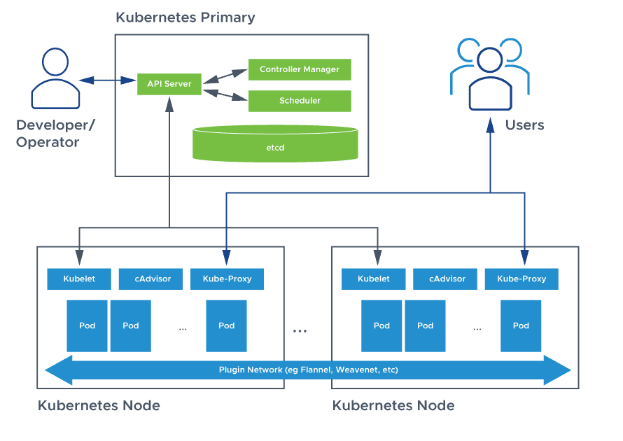

Slide 21
Kubernetes Installation summary
Identify Master and slave nodes.
Install docker in all of them.
Install kubeadm, kubelet and kubectl in all of them
Install Go language in all of them
Install Container run time in all of them
Initialize master cluster, and you would be getting join command, run join command in nodes.
Enable network for communication between nodes.
Validate the infrastructure by running kubectl get nodes

Slide 22
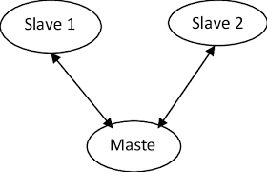
1) Our setup
1 master, 2 slave.

Slide 23
1) Least privilege vs most privilege
When we are creating virtual machine user will get the least privilege, even it is not able to install the docker.
Now, if we have requirement for any installation then we need to turn to most privileged access, by executing the below command
sudo su -

Slide 24
2) Login to all box with root user and install docker
apt-get update
apt install docker.io -y

Slide 25
3) Install kubelet, kubeadm and kubectl
apt-get update
# apt-transport-https may be a dummy package; if so, you can skip that package
apt-get install -y apt-transport-https ca-certificates curl gpg -y
mkdir -p -m 755 /etc/apt/keyrings
curl -fsSL https://pkgs.k8s.io/core:/stable:/v1.30/deb/Release.key | gpg --dearmor -o /etc/apt/keyrings/kubernetes-apt-keyring.gpg
# This overwrites any existing configuration in /etc/apt/sources.list.d/kubernetes.list
echo 'deb [signed-by=/etc/apt/keyrings/kubernetes-apt-keyring.gpg] https://pkgs.k8s.io/core:/stable:/v1.30/deb/ /' | tee /etc/apt/sources.list.d/kubernetes.list
apt-get update
apt-get install -y kubelet kubeadm kubectl
apt-mark hold kubelet kubeadm kubectl
Link: https://kubernetes.io/docs/setup/production-environment/tools/kubeadm/install-kubeadm/#installing-kubeadm-kubelet-and-kubectl

Slide 26
4) Install Go language
wget https://golang.org/dl/go1.20.linux-amd64.tar.gz
tar -C /usr/local -xzf go1.20.linux-amd64.tar.gz
echo "export PATH=\$PATH:/usr/local/go/bin" >> ~/.profile
source ~/.profile

Slide 27
5) Installing container run time
wget https://github.com/Mirantis/cri-dockerd/releases/download/v0.2.0/cri-dockerd-v0.2.0-linux-amd64.tar.gz
tar xvf cri-dockerd-v0.2.0-linux-amd64.tar.gz

Slide 28
Initialize master only not slave
kubeadm init

Slide 29
Output of init command
To start using your cluster, you need to run the following as a regular user:
mkdir -p $HOME/.kube
sudo cp -i /etc/kubernetes/admin.conf $HOME/.kube/config
sudo chown $(id -u):$(id -g) $HOME/.kube/config
Alternatively, if you are the root user, you can run:
export KUBECONFIG=/etc/kubernetes/admin.conf
You should now deploy a pod network to the cluster.
Run "kubectl apply -f [podnetwork].yaml" with one of the options listed at:
https://kubernetes.io/docs/concepts/cluster-administration/addons/
Then you can join any number of worker nodes by running the following on each as root:
kubeadm join 10.0.0.5:6443 --token f9zz3v.zlm2l3ki8jmiso9z \
--discovery-token-ca-cert-hash sha256:0f95d518a316f089a5ce3b74079e08421e454ec0b6c7ecadb645d5e11690af81

Slide 30
Install network on master only
mkdir -p $HOME/.kube
sudo cp -i /etc/kubernetes/admin.conf $HOME/.kube/config
sudo chown $(id -u):$(id -g) $HOME/.kube/config
kubectl apply -f https://docs.projectcalico.org/manifests/calico.yaml

Slide 31
Run Join command into slave nodes
kubeadm join 10.0.0.5:6443 --token <token>\
--discovery-token-ca-cert-hash <Hashcode>

Slide 32
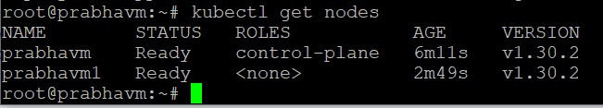
Run kubectl get nodes commands
Run kubectl get nodes to see the nodes

